Slide 1
Tribal Census 101
Shadana Sultan, Oglala Lakota
Shadana.M.Sultan@Census.gov
720-606-1938

Slide 2
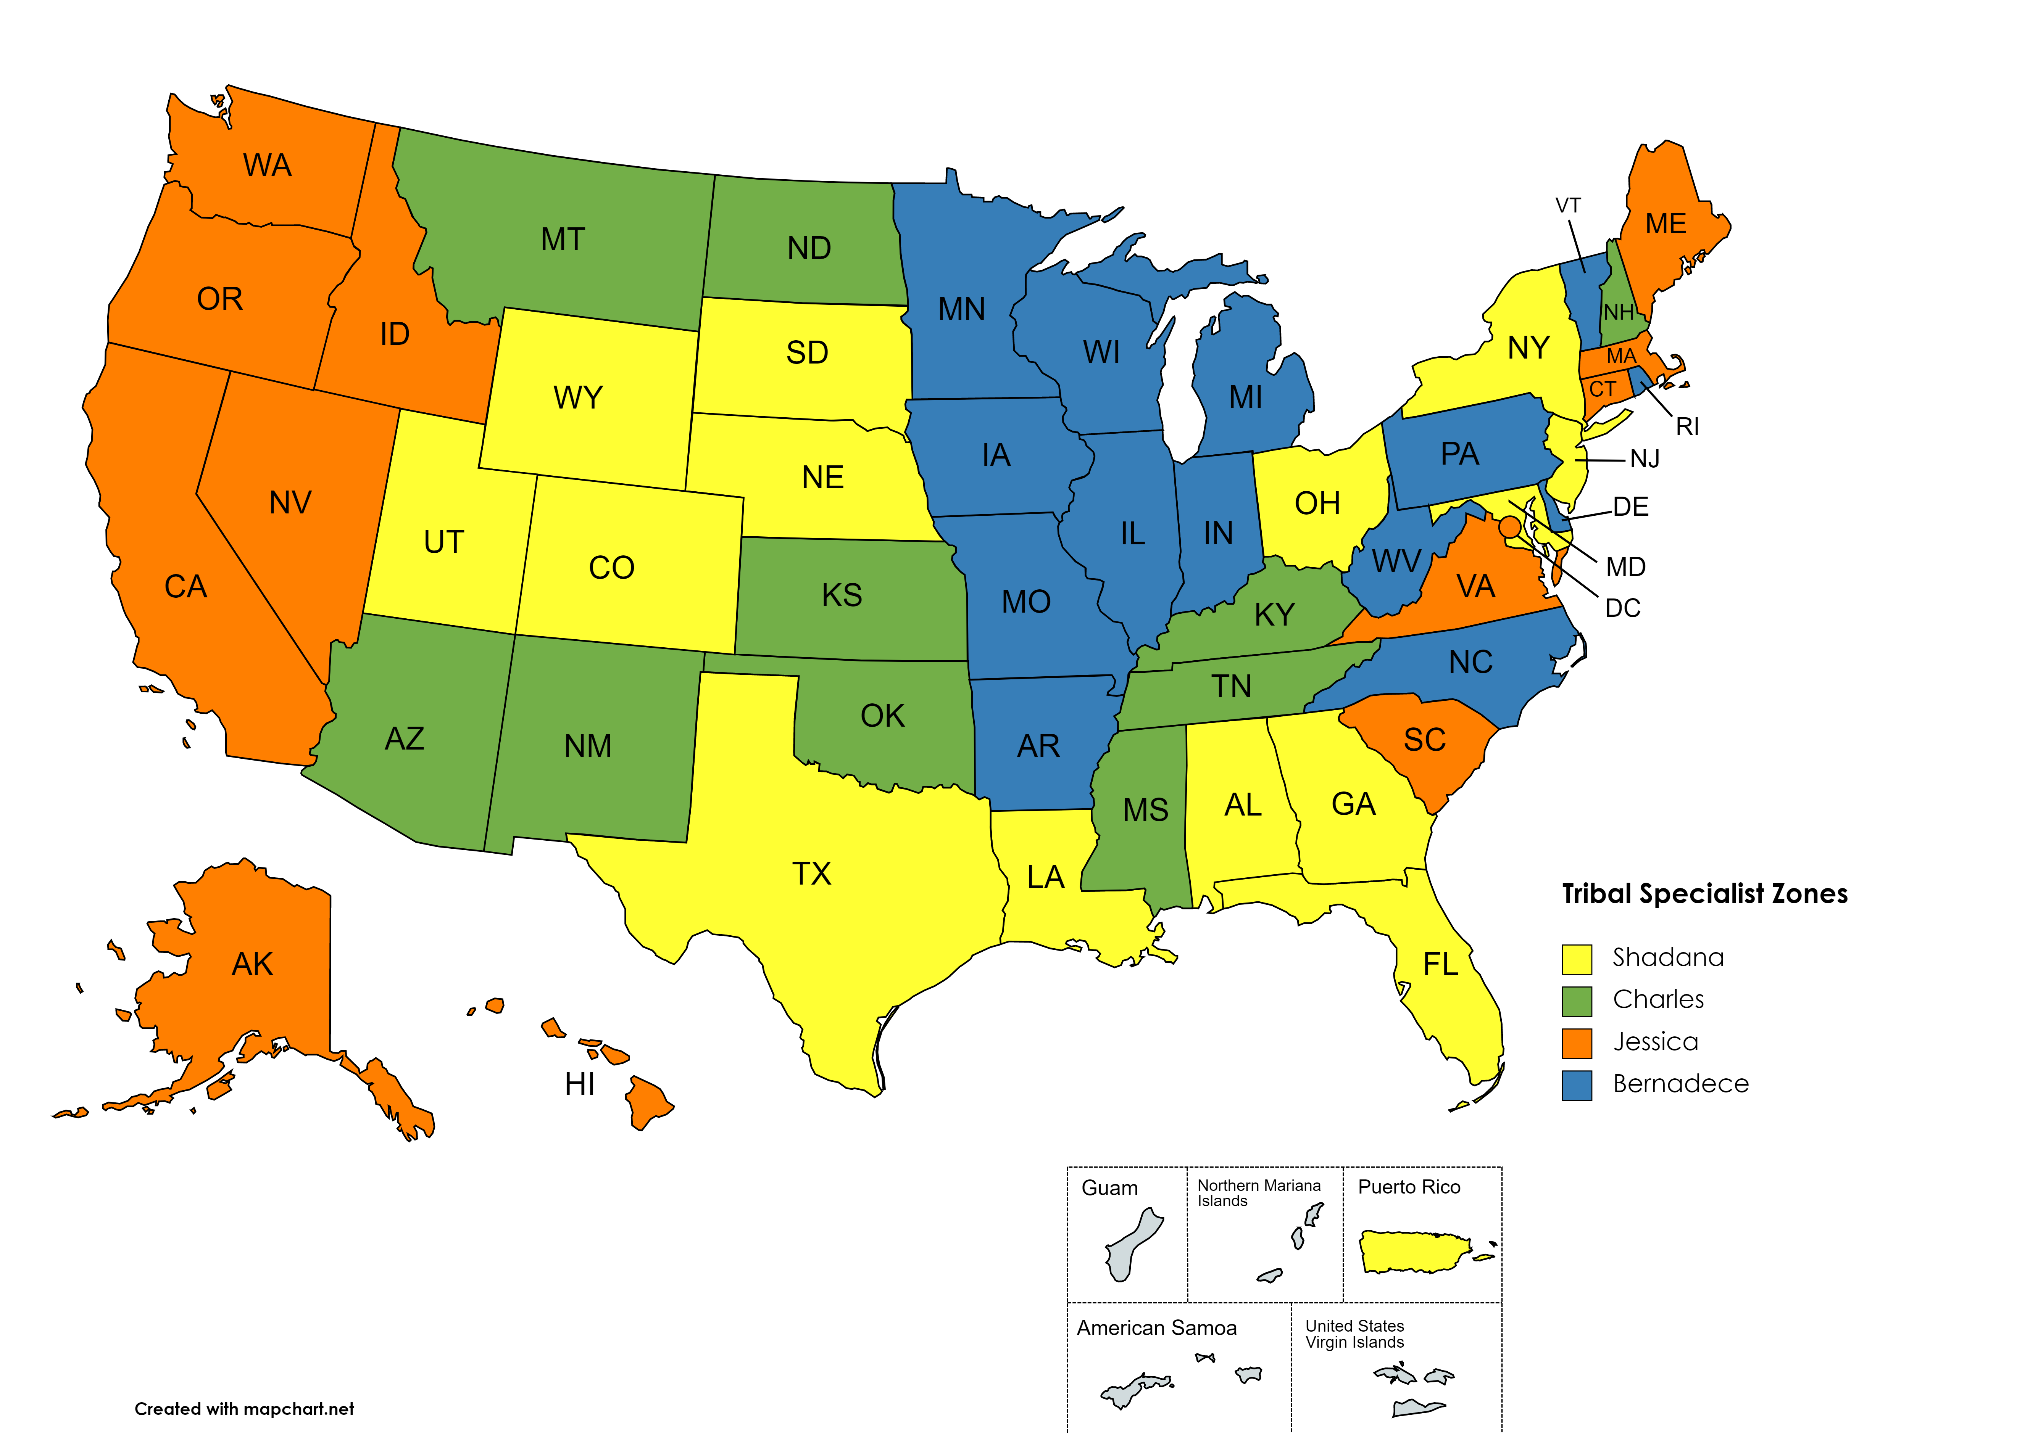
Tribal Relations Overview
Tribal Data Tabulation
Engage Partners
Updates and resources for ongoing surveys
Surveys & Upcoming 2030 Census
Geographic Programs
Cultural Awareness and Engagement
Field and other Directorates

Slide 3

Why Census Data?
…In addition to its use in fair voting representation, census data play a key role in the fair distribution of billions of dollars to tribes and AI/AN people across the nation. Federal funding for Indian schools, Indian education programs, Indian health programs, Indian housing programs, water and sewage projects, roads, and economic development are distributed based on data collected by the Census Bureau….
National Congress of American Indians website
https://www.ncai.org/policy-issues/economic-development-commerce/census

Slide 4

Tribal Data Tabulation
Geography
  Where people live, not Enrollment.
  Tribal Land and Urban counts
Race/Ethnicity
  Self-identification
  AIAN Category

Slide 5
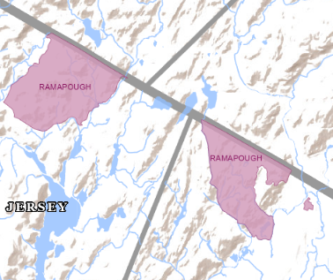
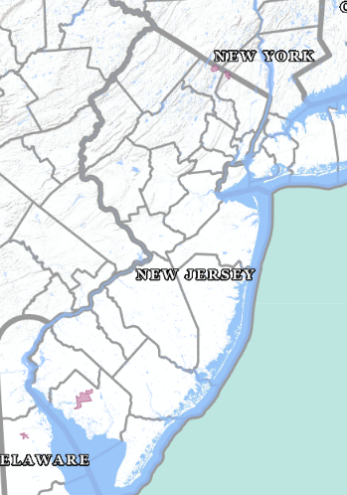
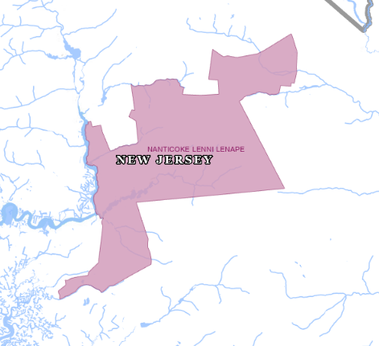
Tribal Geography: AIAN Areas
  Reservations (AIR’s)
  State Designated Statistical Areas
  Tribal Subdivisions
  Census Designated Places (CDP’s)
  Tribal Designated Statistical Areas
https://www2.census.gov/geo/pdfs/reference/geodiagram.pdf

Slide 6

Tribal Geography Resources
  Localized data
    Tribal Subdivisions
    CDP
  BAS / LUCA
  ESRI GIS
  BIA Training
  Geography Ambassador

Slide 7
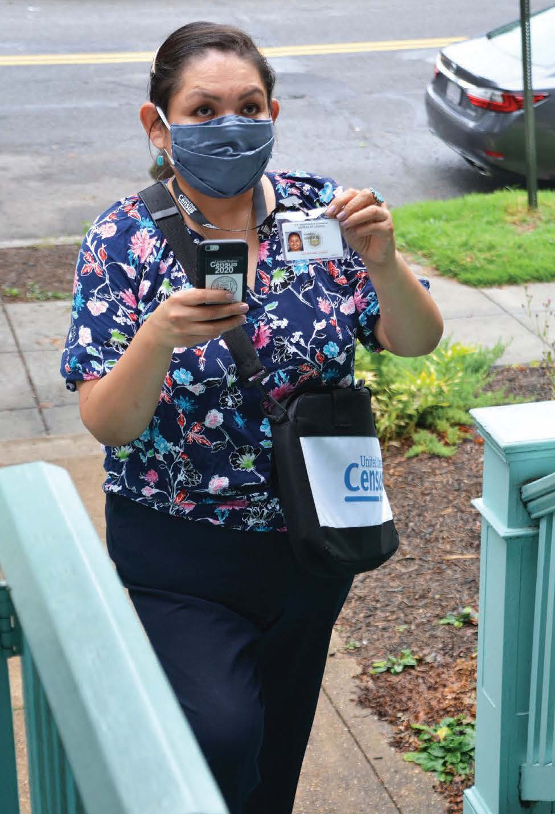
Ongoing Surveys
130+ Surveys each year
Decennial
  Post Enumeration Survey (PES) – Oct 2021
  Access/permissions
American Community Survey (ACS)
Household Pulse Survey
Current Population Survey
Census is Hiring!!
https://www.census.gov/programs-surveys/surveys-programs.html

Slide 8

Online Census Data Tools for Indian Country

Slide 9
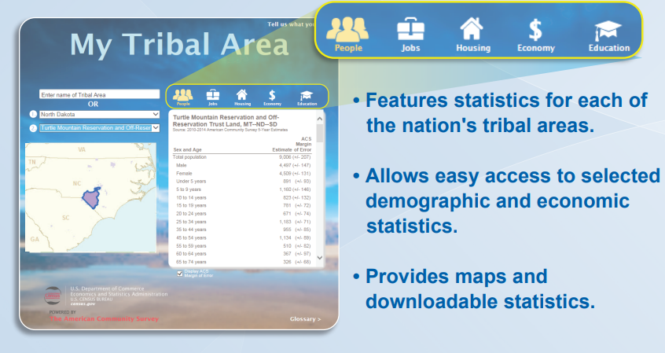
My Tribal Area
Demographic, social, economic, and housing Stats (ACS)
AIAN Lands (not Urban)
Community Planners
Grant Writers
Tribal Officers/Directors
Partners to Tribal Nations

Slide 10
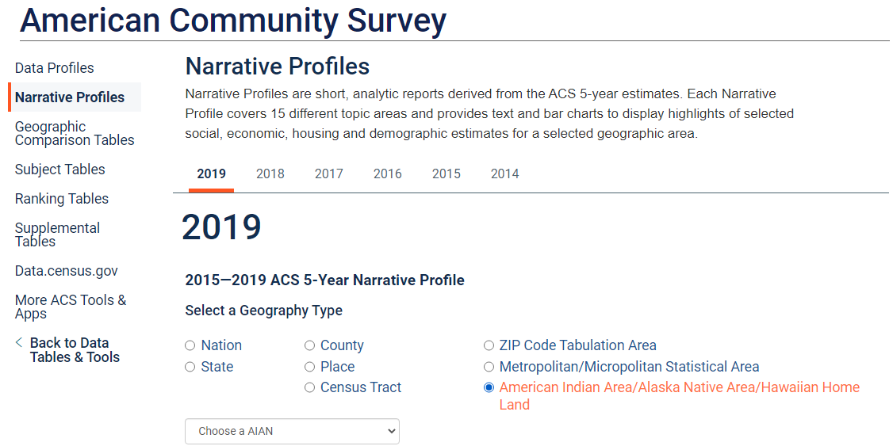
Narrative Profile
https://www.census.gov/acs/www/data/data-tables-and-tools/
Notes:
Live demo….localized.

Slide 11
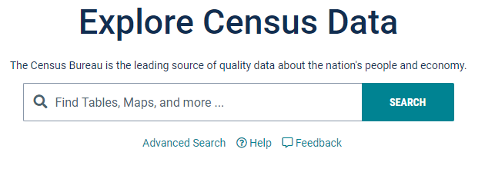
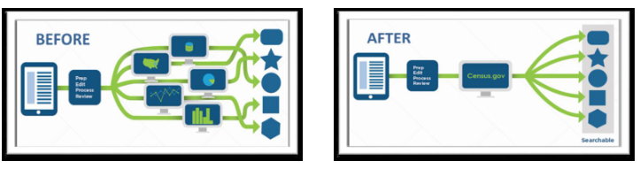
www.Data.Census.gov
Centralized data hub
Tribal Leaders/Officers
Community Planners
Grant Writers
Anyone needing data

Slide 12

Q&A
DDS
1-844-ASK-DATA or census.askdata@census.gov
We want your feedback! Is there anything you'd like to see from Census?

